Slide 1
Software Requirements Engineering
By
Abid Ali
BS Software Engineering
5th
Lecture #9

Slide 2
Agenda
Scope representation techniques . . . . . . . . . .
Context diagram . . . . . . . . . . . . . .
Ecosystem map . . . . . . . . . . . . . . . . . .
Feature tree . . . . . . . . . . . . . . . . . . . . . .
Event list . . . . . . . . . . . . . . . . . . . . . . . . . . . .

Slide 3
Scope representation techniques
Introduction:
Context diagrams, ecosystem maps, feature trees, and event lists are the most common ways to represent scope visually.
However, other techniques are also used. Identifying affected business processes also can help define the scope boundary.
Use case diagrams can depict the scope boundary between use cases and actors

Slide 4
Context diagram
The scope description establishes the boundary and connections between the system you’re developing and everything else in the universe.
The context diagram visually illustrates this boundary.
It identifies external entities (also called terminators) outside the system that interface to it in some way, as well as data, control, and material flows between the terminators and the system.
The context diagram is the top level in a data flow diagram developed according to the principles of structured analysis (Robertson and Robertson 1994), but it’s a useful model for all projects

Slide 5
Figure 5-6 illustrates a portion of the context diagram for the Chemical Tracking System.
The entire system is depicted as a single circle; the context diagram deliberately provides no visibility into the system’s internal objects, processes, or data.
The “system” inside the circle could encompass any combination of software, hardware, and human components.
Therefore, it could include manual operations as part of the entire system.
The external entities in the rectangles can represent user classes (Chemist, Buyer), organizations (Health and Safety Department), other systems (Training Database), or hardware devices (Bar Code Reader).
The arrows on the diagram represent the flow of data (such as a request for a chemical) or physical items (such as a chemical container) between the system and its external entities.

Slide 6
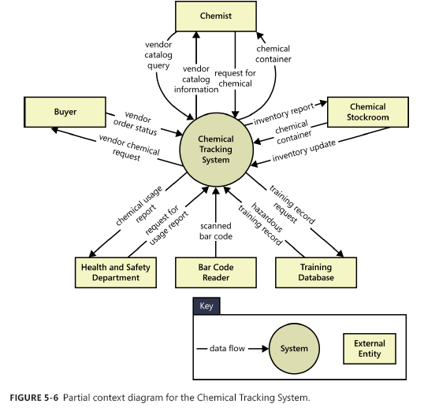

Slide 7
Some of the benefits of a Context Diagram are:
Shows the scope and boundaries of a system at a glance including the other systems that interface with it
No technical knowledge is assumed or required to understand the diagram
Easy to draw and amend due to its limited notation
Easy to expand by adding different levels of DFDs
Can benefit a wide audience including stakeholders, business analyst, data analysts, developers.

Slide 8
Ecosystem map
An ecosystem map shows all of the systems related to the system of interest that interact with one another and the nature of those interactions (Beatty and Chen 2012).
An ecosystem map represents scope by showing all the systems that interconnect and that therefore might need to be modified to accommodate your new system.
Ecosystem maps differ from context diagrams in that they show other systems that have a relationship with the system you’re working on, including those without direct interfaces.
You can identify the affected systems by determining which ones consume data from your system.
When you reach the point that your project does not affect any additional data, you’ve identified the scope boundary of systems that participate in the solution.

Slide 9
Figure 5-7 is a partial ecosystem map for the Chemical Tracking System.
The systems are all shown in boxes (such as the Purchasing System or Receiving System).
In this example, the primary system we are working on is shown in a bold box (Chemical Tracking System), but if all systems have equal status in your solution, you can use the same box style for all of them.
The lines show interfaces between systems (for instance, the Purchasing System interfaces to the Chemical Tracking System). Lines with arrows and labels show that major pieces of data are flowing from one system to another (for instance, “training records” are passed from the Corporate Training Database to the Chemical Tracking System).

Slide 10
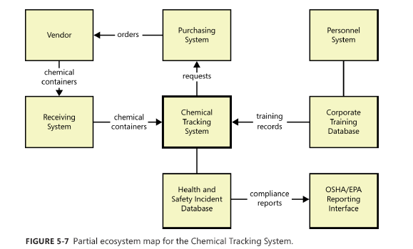

Slide 11
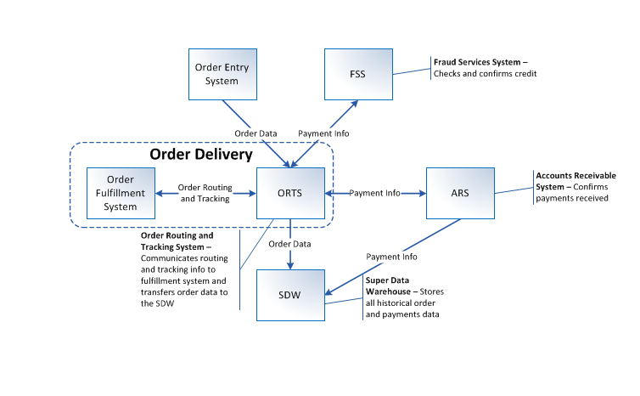
Example

Slide 12
Feature tree
A feature tree is a visual depiction of the product’s features organized in logical groups, hierarchically subdividing each feature into further levels of detail (Beatty and Chen 2012).
The feature tree provides a concise view of all of the features planned for a project, making it an ideal model to show to executives who want a quick glance at the project scope.
A feature tree can show up to three levels of features, commonly called level 1 (L1), level 2 (L2), and level 3 (L3). L2 features are subfeatures of L1 features, and L3 features are subfeatures of L2 features

Slide 13
Figure 5-8 shows a partial feature tree for the Chemical Tracking System.
The main branch of the tree in the middle represents the product being implemented.
Each feature has its own line or “branch” coming off that central main branch.
The gray boxes represent the L1 features, such as Order Chemicals and Inventory Management.

Slide 14
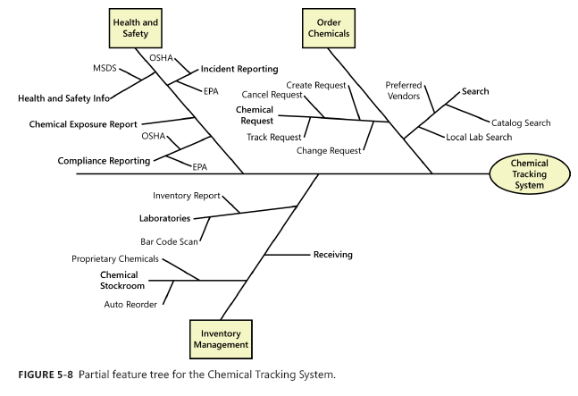

Slide 15
Event list
An event list identifies external events that could trigger behavior in the system.
The event list depicts the scope boundary for the system by naming possible business events triggered by users, time-triggered (temporal) events, or signal events received from external components, such as hardware devices.
The event list only names the events; the functional requirements that describe how the system responds to the events would be detailed in the SRS by using event-response tables

Slide 16
